Slide 1
Chapter 8 – Organizational Culture

Slide 2
Introduction to Organizational Culture
Organizational culture is a defined as a set of beliefs, values, and assumptions that are shared by members of an organization. these underlying values have an influence on the behavior of organizational members, as employees rely on these values to guide their decisions and behaviors.

Slide 3
Organizational Culture
Aspects of Organizational Culture Gerry Johnson (1988) described a cultural web, identifying a number of elements that can be used to describe or influence organizational culture:
The paradigm: What the organization is about, what it does, its mission, its values.
Control systems: The processes in place to monitor what is going on. Role cultures would have vast rulebooks. There would be more reliance on individualism in a power culture.
Organizational structures: Reporting lines, hierarchies, and the way that work flows through the business.
Power structures: Who makes the decisions, how widely spread is power, and on what is power based?
Symbols: These include organizational logos and designs, but also extend to symbols of power such as parking spaces and executive washrooms.
Rituals and routines: Management meetings, board reports and so on may become more habitual than necessary.
Stories and myths: build up about people and events, and convey a message about what is valued within the organization.
These elements may overlap. Power structures may depend on control systems, which may exploit the very rituals that generate stories which may not be true.

Slide 4
Organizational Culture
The two main reasons why cultures develop in organizations is due to external adaptation and internal integration. External adaptation reflects an evolutionary approach to organizational culture and suggests that cultures develop and persist because they help an organization to survive and flourish. If the culture is valuable, then it holds the potential for generating sustained competitive advantages. Additionally, internal integration is an important function since social structures are required for organizations to exist. Organizational practices are learned through socialization at the workplace. Work environments reinforce culture on a daily basis by encouraging employees to exercise cultural values. Organizational culture is shaped by multiple factors, including the following:
External environment
Industry
Size and nature of the organization’s workforce
Technologies the organization uses
The organization’s history and ownership

Slide 5
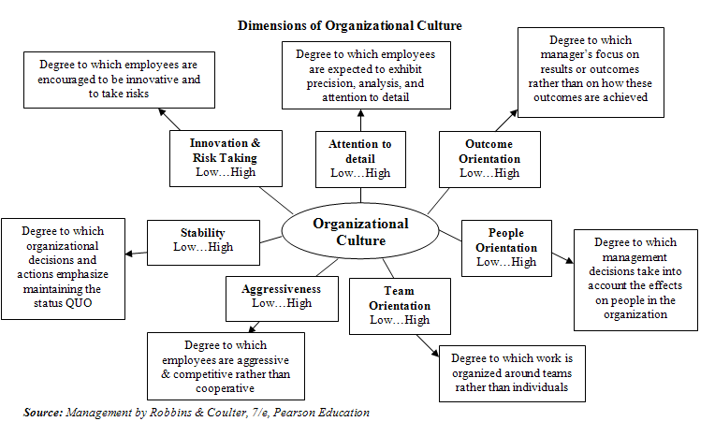

Slide 6
Knowledge Workers
What are Knowledge Workers?
Opposite of manual work
Making complex decisions that others act upon
Specialized expertise
Manage other Knowledge Workers
Traditional Productivity - Outputs/Inputs Knowledge Worker Productivity - Perceived Outputs/Inputs overtime
Characteristics of Knowledge Workers
High level of expertise
Autonomous
Job Involvement
Stimulating social interaction patterns
Management & Organizational Culture Needs of Knowledge Workers
Supportive work climate
Participation leadership interaction style
Access to resources
Positive interactions

Slide 7
Knowledge Workers
Issues with Managing Knowledge Workers
Division and integration of labor
Assessment of Intangible work
Workload and staffing
Identified strengths and weaknesses
What can you do to motivate Knowledge Workers? Strong knowledge workers are intrinsically motivated, so allow them to run full steam and only pull back the reigns when absolutely necessary.
Provide them with intriguing and interesting projects and tasks; keeping things fresh, keeps knowledge workers engaged.
Develop a sense of pride within your organization

Slide 8
Policies for Facilitating Diversity
1. Optimize Performance and Gain Competitive Advantage by Creating Innovative Teams comprised of representatives from a wide variety of functions. (Increase Functional Diversity)
2. Maximize Inclusion by encouraging collaborative learning. Help your team members learn from one another.
3. Use creative methods to cultivate psychological safety in your team (members with unique perspectives must feel comfortable voicing their own opinions.) Brainstorming is brain-forming.
4. Use “skip-level” methods to foster candid and open discussion and feedback without fear of retribution.
5. Don’t take the easy path and settle for shared mindsets. Innovation is radical, do radical things to achieve it.

Slide 9
Organizational Culture and Effectiveness
When looking at employee culture, it is important to understand that two dimensions of an organization can be analyze, employee satisfaction and effectiveness. Focusing on how culture relates to employee effectiveness, this article reviews a study completed at 99 hospitals which assessed the relationship between organizational culture, patient satisfaction, and controllable expenses. In order to review the relationship between culture and effectiveness, we need to understand the many dimensions of an organizations culture.
CVF Domains of Organizational Culture:
Group Culture - Group dynamics and having a sense of belonging to the group
Developmental Culture - Orientation to change and adaptation in hopes of growing the organization.
Rational Culture - Goal setting and attainment as a form of directing employee behavior towards the external environment
Hierarchical Culture - Uniformity and coordination with an emphasis on internal efficiency
Balanced Culture - when values associated with each of the other four domains are strongly held

Slide 10
Organizational Culture and Effectiveness
The hypothesis' developed in this article are as follows:
An organization's emphasis on the group culture domain will positively correlate with organizational effectiveness.
Organizations with strong, well-balanced cultures will achieve higher levels of effectiveness than organizations with un-balanced cultures
Employees attitudes will mediate the relationship between organizational culture and effectiveness
In order to accurately measure and determine conclusion on the hypothesis variable measures including: CVF culture domains, balance, employee satisfaction, physician satisfaction, controllable expenses, and patient satisfaction. Hypothesis one was measured by comparing changes in organizations culture domains, controllable expenses and patient satisfaction scores. Hypothesis two was measured by comparing controllable expenses and patient satisfaction to the differences in hospital which were identified as balanced and those that were seen as unbalanced. Hypothesis three was tested by surveying employees and relating the results to controllable expenses and patient satisfaction.
The results, although not very inspiring, showed that there was little relation to organizational culture and employee effectiveness or patient satisfaction. As hypothesis one, two and three were discredited, one upside which was seen revolved around the relationship between a good organizational culture and high employee satisfaction. Even though not directly related to the researchers goals, this does provide insight into the value of developing a positive and supportive culture.

Slide 11
Four Faces of Organizational Culture
The culture of an organization is derived from the human relationships developed and sustained over time. The four perspectives of organizational described and compared in this paper are: human relations, software of the mind, process consultation, and appreciative inquiry.
Human Relations Highlighting the famous Hawthorne research, which involved altering the level of lighting in a production environment, showed that no matter what the change involved, effectiveness increased. Thus demonstrating that when employees shared their experiences, frustrations, and fears with one another, their spirits were lifted and they created an informal bond. As that bond was strengthened, the shortcuts learned by one were taught and kept secret from managers.
Software of the Mind Ever since we have been brought up by children, a set of values has been instilled in us by the adults that took part in our upbringing. These values have been defined as "Software of the Mind". In addition to this core set of values, three progressive layers build upon them known as: rituals, heroes, and symbols. To develop the progressive layers, four dimensions have were identified that directly contributed to their creation. These dimensions were: power distance, collectivism versus individualism, femininity versus masculinity, and uncertainty avoidance. Per multiple studies, by having employees with similar software's of the mind, a stronger culture was able to be developed.

Slide 12
Four Faces of Organizational Culture
Process Consultation As previously discussed, change is needed to improve each firms position in the market place. When determining how to change a procedure, analyst would often start with a SWOT analysis. As a part of the SWOT analysis, engaging the existing procedure and understanding the behavioral norms of those involved in the procedure increases change effectiveness.
Appreciative Inquiry Another way to foster an open culture is to ask key stakeholder what they think could be improved upon. If leaders are interested in engaging employees, the three following questions could be used to identify potential opportunities: What are you peak positive experiences at our organization?
How would you define your individual, work, and organizational values?
If you could change three things, what would they be?
In contrast to process consultation, appreciative inquiry allows employees to generate their own ideas and become more receptive to ideas that they feel have been generated from their suggestions.

Slide 13
Organizational Culture Assessment Exercise
Goal: To better understand the norms, styles, communication, vision, and ways of relating to one another within the organization.
Questions to consider (discuss with manager):
What are some observed norms on the team? How am I contributing to them? How can we reinforce the good ones and get rid of the bad ones?
What is the observed mission of the organization? How do you fit within that mission?
How do you see others communicating within the company? Is it effective? How can you adjust / align accordingly?
What is the vision of the company? Is it clear? How can I communicate it to others?
What are some things that are rewarded / emphasized with respect to work performance and flow (hours, professionalism, and quality)?
How are norms and rules enforced? Can you work within these guidelines / adapt?
As you have spent some time here, what have you observed with the way employees relate to one another? What works / does not?
What norms have you noticed in meetings and relations with leadership?

Slide 14
References
Brian T. Gregory, Stanley G. Harris, Achilles A. Armenakis, Christopher L. Shook, Organizational culture and effectiveness: A study of values, attitudes, and organizational outcomes, Journal of Business Research, Volume 62, Issue 7, July 2009, Pages 673-679, ISSN 0148-2963, http://dx.doi.org/10.1016/j.jbusres.2008.05.021.
Bruce Fortado, Paul Fadil, (2012) "The four faces of organizational culture", Competitiveness Review: An International Business Journal incorporating Journal of Global Competitiveness, Vol. 22 Iss: 4, pp.283 - 298 - See more at: http://www.emeraldinsight.com.prox.lib.ncsu.edu/journals.htm?articleid=17045649&show=abstract#sthash.8TMOc0jx.dpuf
http://www.laynetworks.com/Cultural-Diversity-Negotiations1.htm

