Slide 1
Chapter 5: Motivation

Slide 2
What is Motivation?
Motivation is basis and a psychological feature that arouses an organism to act towards a desired goal and elicits, controls, and sustains certain goal-directed behaviors. It can be considered a driving force; a psychological one that compels or reinforces an action toward a desired goal. For example, hunger is a motivation that elicits a desire to eat. Motivation is the purpose or psychological cause of an action. Motivation has been shown to have roots in physiological, behavioral, cognitive, and social areas. Motivation may be rooted in a basic impulse to optimize well-being, minimize physical pain and maximize pleasure. It can also originate from specific physical needs such as eating, sleeping or resting, and sex. Motivation is an inner drive to behave or act in a certain manner. "It's the difference between waking up before dawn to pound the pavement and lazing around the house all day." These inner conditions such as wishes, desires and goals, activate to move in a particular direction in behavior.

Slide 3
Three Aspects of a Job
Functional What am I supposed to do? Who will help? How will I be evaluated? What will I be paid?
Psychological How hard do I have to work? What recognition/reward will I receive?
Social Does my organization have similar value to my own? What are the informal rules of my organization?

Slide 4
Maslow’s Hierarchy of Needs
Physiological Needs: The physical requirements for human survival, without meeting these needs the human body is unable to survive. Air, water, and food are required nutrients for survival. Clothing and shelter provide essential protection from nature.
Safety Needs: With an individual's physical needs relatively satisfied, the individual's safety needs take precedence and dominate behavior. Safety and Security needs include: Personal security
Financial security
Health and well-being
Safety net against accidents/illness and their adverse impacts
Love and Belonging Needs: The third level of human needs is interpersonal and involves feelings of belonging. The different types of relationships include: Friendship
Intimacy
Family
According to Maslow, humans need to feel a sense of belonging and acceptance among their social groups, regardless if these groups are large or small.

Slide 5
Maslow’s Hierarchy of Needs
Esteem: All humans have a need to feel respected; this includes the need to have self-esteem and self-respect. Esteem presents the typical human desire to be accepted and valued by others. People often engage in a profession or hobby to gain recognition. These activities give the person a sense of contribution or value. Maslow's two separate types of esteem needs include: The "lower" version of esteem, which is the need for respect from others. This may include a need for:
Status
Recognition
Fame
Prestige
Attention.
The "higher" version manifests itself as the need for self-respect. This may include a need for: Strength
Competence
Mastery
Self-confidence
Independence
Freedom
The "higher" version takes precedence over the "lower" version because it relies on an inner competence established through experience.

Slide 6
Maslow’s Hierarchy of Needs
Self-actualization: This level of need refers to what a person's full potential is and the realization of that potential. Maslow describes this level as the desire to accomplish everything that one can, to become the most that one can be. Maslow believed that to understand this level of need, the person must not only achieve the previous needs, but master them.

Slide 7
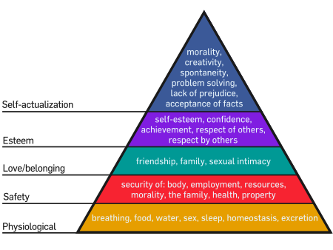
Maslow’s Hierarchy of Needs

Slide 8
Additional Motivational Theories
Hawthorn Effect - When you pay attention to people, they will become more productive.
Equity Theory - Relationships between the input(pay) and output(production) between different employees.
Motivational Force - The subconscious calculation used to determine ones concentration and effort applied to achieving a goal. Expectancy (If you work, you will perform) x Instrumentality (If you perform, there will be outcomes) x Valence (The outcomes will be valued) =Total Motivational Force *A similar theory on motivation will be discussed in the article section.

Slide 9
Additional Motivational Theories
Intrinsic vs. Extrinsic Motivation: Intrinsic motivation refers to motivation that is driven by an interest or enjoyment in the task itself, and exists within the individual rather than relying on external pressures or a desire for reward. Individuals are likely to be intrinsically motivated if they:
attribute their production results to factors under their own control
believe they have the skills to be effective agents in reaching their desired goals
are interested in mastering a task, not just focused on completing the given responsibility
Extrinsic motivation refers to the performance of an activity in order to attain an outcome, whether or not that activity is also intrinsically motivated. Extrinsic motivation comes from outside of the individual. The most common being rewards and punishment

Slide 10
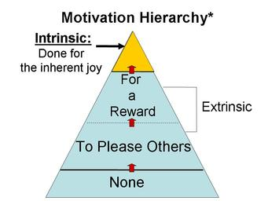

Slide 11
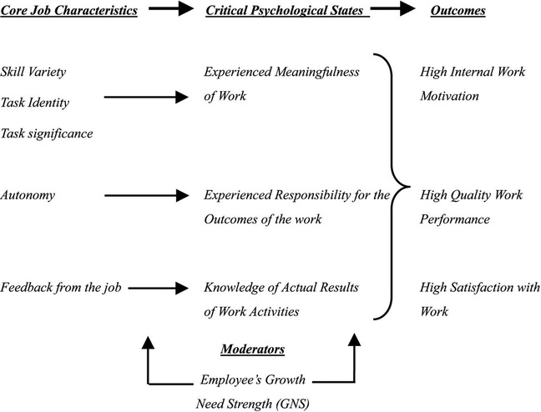
Motivation Through Job Design

Slide 12
Motivation Through Job Design
To expand upon the five core job characteristics, leaders must initiate and develop their social capital with three aspects:
The structural dimension, which concerns the overall pattern of relationships found in organizations
The relational dimension, which concerns the nature of the connections between individuals in an organization
The cognitive dimension, which concerns the extent to which employees within a social network share a common perspective or understanding
By developing the three aspects, employers will improve coordination, reduce transaction costs, and facility information flow between employees. By utilizing the theories discussed in this article, employers can appropriately design job roles which allow their employees to become highly effective, concentrated, and cooperative individuals.

Slide 13
Employee Motivation: A powerful new model
The four underlying motivational drivers are as follows:
Drive to Acquire - A desire to acquire scarce goods that bolster our sense of well-being and status among others.
Drive to Bond - A need for a feeling of belonging, inclusion and connection while minimizing the sense of loneliness
Drive to Comprehend - A desire to continuously develop, understand, and provide meaningful contributions
Drive to Defend - A need for the sense of security and confidence while minimizing fear and resentment.

Slide 14
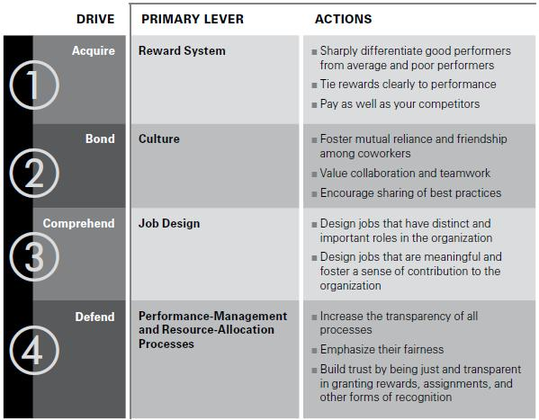
Employee Motivation: A powerful new model

Slide 15
Motivating Employees
Some positive personnel practices that have been developed in an attempt to motivate employees are:
Reducing time spent at work
Upward Spiraling Wages
Fringe Benefits
Human Relations Training
Sensitivity Training
Communications
Two-way Communication
Job Participation
Employee Counseling

Slide 16
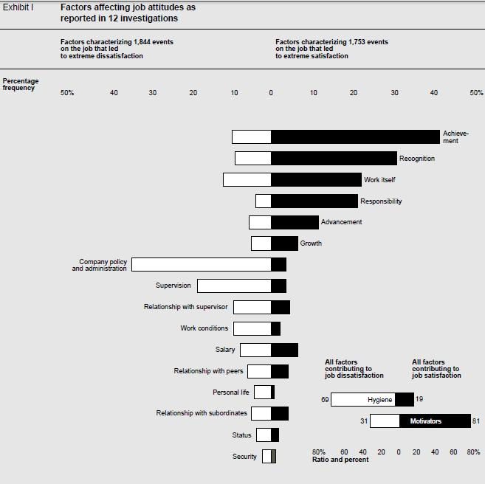

Slide 17
Employee Motivation Exercise
To find out what really motivates your employees as individuals, try this exercise. Compose a survey of motivators and ask your employees to rank them in the order of importance, with No. 1 being the most important. Include categories covering career development, comfort, work-life balance, leadership, learning, possessions, recognition, financial security, popularity, status, task accomplishment, teaching or mentoring others, vitality and others. Include a section for comments about improving the work environment. Before inviting employees to take the survey, take it yourself. As a manager, understanding what really motivates you may help you motivate your employees. Then give the survey to your employees and collect the results.
One-on-One Meetings with Employees After collecting the surveys, set up a meeting with each employee individually to talk about the meaning of the survey and to discuss what really motivates them. Conduct these meetings in a quiet place with no interruptions. As busy as you may be, one of the most important things you can give an employee is your undivided attention. The meeting itself can be a source of motivation to many employees who would just like the opportunity to chat about their jobs and what drives them to succeed.

Slide 18
Employee Motivation Exercise
Follow Up Now that you have the results of the surveys and you have met with each employee individually, you must act upon the results. It is possible to customize a motivation plan for each employee. This is not to say that you should give one employee a raise and another a pat on the back, if they both deserve a raise. Instead, commit to an initial plan that involves employee recognition for exceptional work. This could mean rewards or incentives that are customized to each employee. For example, an employee who ranked increasing knowledge as number one in the survey could be rewarded by being allowed to attend an industry conference. Another employee may well appreciate compensation time for overtime worked. Each plan should be based with the individual in mind.
Considerations Not all employee motivation plans are made up of incentives. After reading the surveys, you may decide as a manager that your organizational culture needs an overhaul. Consider how you can improve your company's working environment for everyone who works there. Perhaps you can implement a new work schedule where employees get one Friday off per month. There are numerous ideas that can be implemented both in improving the physical surroundings and the psychological impact of the work environment. Motivating your employees may take more than the traditional gift card or plaque in the hallway. Give the results of the survey plenty of consideration and think outside of the box to improve your workplace

Slide 19
References
Pooja Garg, Renu Rastogi, (2006) "New model of job design: motivating employees' performance", Journal of Management Development, Vol. 25 Iss: 6, pp.572 - 587 - See more at: http://www.emeraldinsight.com.prox.lib.ncsu.edu/journals.htm?articleid=1556757&show=abstract#sthash.nvGVGBIh.dpuf Nohria, Nitin, Boris Groysberg, and Linda-Eling Lee. "Employee Motivation: A Powerful New Model." HBS Centennial Issue. Harvard Business Review 86, nos. 7/8 (July–August 2008): 78–84. Herzberg, Frederick. "One More Time: How Do You Motivate Employees?" Harvard Business Review (2003): n. pag. Harvard Business Review. Jan. 2003. Web. 5 Nov. 2013. http://www.edpsycinteractive.org/topics/conation/maslow.html http://smallbusiness.chron.com/training-exercise-understand-employee-motivation-19290.html

