Slide 1
Chapter 10 – Business Ethics

Slide 2
Introduction to Business Ethics
Proper business policies and practices regarding potentially controversial issues, such as corporate governance, insider trading, bribery, discrimination, corporate social responsibility and fiduciary responsibilities. Business ethics are often guided by law, while other times provide a basic framework that businesses may choose to follow in order to gain public acceptance.

Slide 3
Some professional organizations define their ethical approach in terms of a number of discrete components. Typically these include:
Honesty
Integrity
Transparency
Accountability
Confidentiality
Objectivity
Respectfulness
Obedience to the law
Loyalty

Slide 4
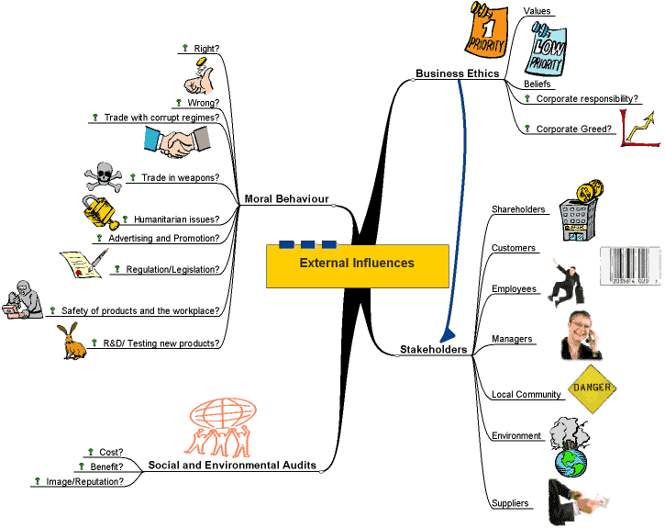

Slide 5
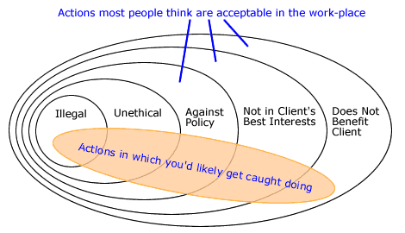
Levels of Unethical Actions

Slide 6
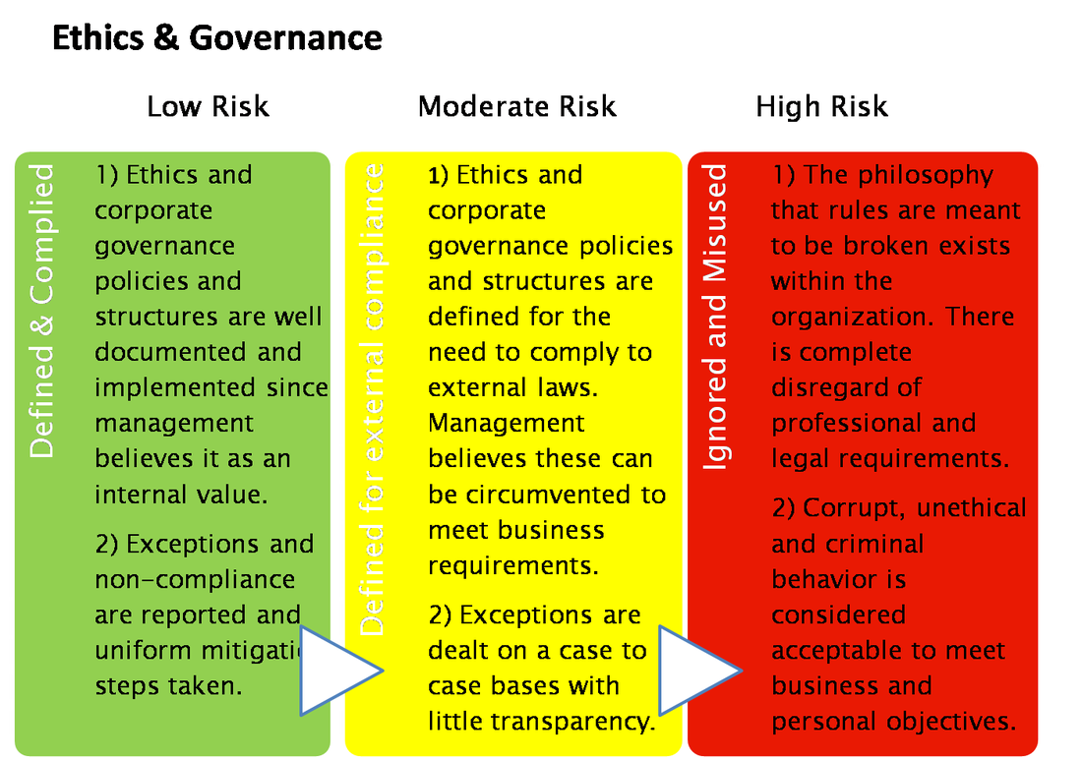

Slide 7
Healthcare Ethics – A Patient Centered Decision Model
The dilemma in healthcare today is how to provide high-quality healthcare while keeping costs at a minimum. Healthcare in the United States is generally provided under two models: fee-for-service and managed care. Under fee-for-service arrangements, doctors set the fee for the services they provide, and patients and/or health insurance companies pay the bill. Until recently, fee-for-service has been the traditional model used in the U.S. In recent years, however, managed care programs have grown significantly. Under managed care programs, third party payers determine how much will be paid for defined medical treatments, and doctors get that amount and no more. The two types of healthcare models: Fee for Service No defined population for which the insurance company is responsible.
Contacts are initiated by patients.
Main focus is on treating sick patients.
The responsibility of the insurance company is to pay the bills.
Physicians decide what care their patients should receive.
Physicians have an incentive to overuse care;
Insurance company has no managerial control over healthcare providers, and there is no centralized decision making.
The locus of the cost/quality trade-off is split:physicians have income incentives to maximize the services they deliver to patients, whereas administrators have market incentives to keep premiums low.
Managed Care The managed care organization (MCO) has responsibility for the health of a defined population.
The MCO is responsible for the entire spectrum of care.
Contacts are initiated both by patients and by the MCO.
The MCO “manages” the actions of physicians.
The MCO has a capacity for centralized decision making.
The cost/quality trade-off comes together at the level of the medical director, who simultaneously feels pressure both to improve quality and to reduce costs.

Slide 8
Healthcare Ethics – A Patient Centered Decision Model
Potential Safe Guards to reduce the threat to patient welfare of the financial incentives and guidelines of managed care:
Disclosure – managed care plans should disclose their policies on physician salaries and guidelines, letting consumers make informed choices.
Professionalism – the Hippocratic oath’s injunction that “into whatever houses I may enter, I will come for the benefit of the sick, remaining clear of all involuntary injustice and of other mischief” must remain a central medical value.
Competition – theoretically, competition could spur healthcare institutions to provide quality care while reducing costs. Ideally, providers who would try to skimp on quality to save money would be forced out of the market.
Limiting financial incentives – in developing policies to regulate financial incentives for physicians, we must recognize two worthy but competing goals – to protect the quality of patient care and to restrain medical care costs. We need to separate doctors’ incentives and remuneration from their patient care decisions as much as possible.
Guideline review boards – mandatory, prospective review of all guidelines, algorithms, or critical pathways of healthcare institutions by an independent board is proposed.
Appeals boards – the establishment of an independent appeals board for each hospital, managed care plan, or group practice is suggested.

Slide 9
Healthcare Ethics – A Patient Centered Decision Model
Business Ethics for Healthcare Organizations
Principal-agent model - Since business managers are agents of the shareholders, then their exclusive job of management is to increase shareholder wealth by increasing the present value of the organization.
Moral reasoning - Morality is viewed as intrinsically good and should be seen as an end in itself, not just as a method for increasing shareholder wealth. In a conflict between moral principles and wealth, morality should always win.
Non-instrumental ethics - Ethics has a moral veto over maximizing shareholder wealth. Business has no special rules that override the moral obligations managers hold as humans. This approach is grounded in the theories of deontological ethics in which moral rightness is not solely dependent on outcomes or results. Four principles common to the general morality of humans include not harming others, respecting authority, avoiding lying, and honoring agreements.
Agent-morality perspective - Moral principles are antecedent to the contract between the principal and agent and cannot be suspended by agreement between them. Only after basic moral duties have been met should shareholder wealth be a priority.
Biomedical Ethics for Physicians
Respect for others – respecting individual autonomy, truth telling, and maintaining confidentiality and fidelity.
Beneficence – providing benefits to persons while at the same time balancing benefit and harm. Organizations are required to do all they can to aid patients.
Non-maleficence – “first do no harm.” An example of the balancing act between providing benefit and doing no harm is when staff are put at risk when treating trauma patients.
Justice – the equitable distribution of benefits and costs among individuals, groups, and organizations. Providing services to medically indigent persons is an example of this ethical standard.

Slide 10
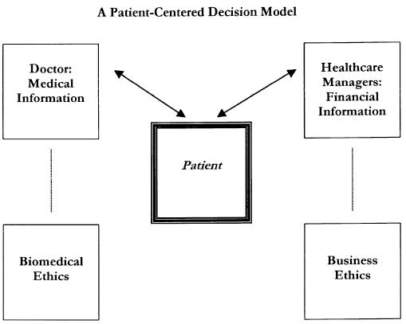

Slide 11
Healthcare Ethics – A Patient Centered Decision Model
The traditional cost/benefit model used in business decisions is uniquely applied in this patient-centered decision model by putting cost/benefit decisions into the hands of the patient.
Currently, healthcare managers or doctors make many healthcare decisions based on cost/benefit information. Since costs and benefits have historically entered into healthcare decisions, and are likely to be an increasingly important part of healthcare decisions in the future, it is important for the patient to be involved in these healthcare decisions.
The decision model proposed in this paper is an innovative application of the cost/benefit model to healthcare decisions. The strength of this model is that it places decisions into the hands of those who are best qualified to make the right decision, and the patient is always involved in the decision.
Moreover, ethics are an essential part of the decision process. Doctors are best qualified to make medical decisions in consultation with the patient and within the framework of biomedical ethics. Healthcare managers are best qualified to deal with financial issues, such as costs and profits, again in consultation with the patient and within the framework of business ethics.
It is the patient, who is at the center of the decision process, who makes the final decision based on appropriate medical and financial information.

Slide 12
Ethics and Economics in Healthcare
As today's healthcare organizations are facing many challenges that put pressure on ethical standards. The ethical challenges the economic changes pose is how to deliver high quality healthcare at the highest possible ethical standards over the next century. In earlier eras of healthcare, ethics had repeatedly trumped economics during the decision making process. Throughout the course of healthcare evolution, the social expectation that hospitals have the responsibility to provide appropriate care at reasonable costs has remained constant. Yet, this standard has become increasingly difficult to meet as "reasonable costs" has come under scrutiny while the quality of care is expected to be maintained if not improved. It has also became more difficult due to the limitations on "reasonable costs" set by non-healthcare providing organizations such as Medicare, Medicaid, and commercial insurance providers.
Quality of Care and Ethics With the implementation of Managed Care pay structures, as described in the article summary above, reimbursement standards drive hospitals to generate appropriate, efficient, and reliable care. Appropriate treatment, at the right time, by the right person, in an appropriate setting represents high quality of care. By utilizing research, hospitals can implement practices which deliver highly effective and ethical care. With the development of Managed Care, considerable attention has been brought to ensure the protection of patients in the following ways:
Informed consent of all medical treatment
Refuse any unwanted medical treatment
Confidentiality and privacy of medical information
Disclosure of relevant medical information
Protection of vulnerable subjects

Slide 13
Ethics and Economics in Healthcare
Although there may be advantages to having reimbursement intermediaries, such as insurance companies, Medicare, or Medicaid; the advantages for quality of care seem problematic. With this issue, people are beginning to worry about how the quality of care will be effected by the effort to reduce costs. The problem does not lie in the desire for economically sustainable healthcare and the emphasis on the appropriate use of resources. These aspects are imperative for any respectable hospital, and need to be recognized as such. The problem lies within the separation of cost management from clinical management, and uncoupling of cost and quality.
Rethinking Ethics in Hospitals In the new age of healthcare, hospital need to become agents of accountability by developing social responsibility in their communities. To do so, instead of thinking that ethics is just something that hospitals do, ethics needs to become the reason that hospitals do something. In order to develop this change, hospitals need to utilize their ethical resources more efficiently. By continuing to develop and implement organizational changes based whats best for the patient, the hospital can effectively balance the changes they make to ensure ethical and economic sustainability.

Slide 14
Ethics Exercise
Introduce situations (e.g., 1-3 below) about which you might contemplate the most ethical responses. One person’s ethical standards may differ from another’s, however, because we all have varying views on what is “right” and “wrong.” Take some time to consider the following situations and how you believe you should – and would – respond. Then, discuss these issues with others to find out if and how your views differ from each other.
(1) Your company/firm wants to sponsor a potentially controversial event (ie. lecture by a polarizing politician or gay marriage/rights speaker) or to engage firm members in pro bono representation of political activists purposefully arrested while protesting at the General Assembly. By simply allowing your company/firm to be associated with this event/representation the company/firm could risk losing credibility. How do you handle this?

Slide 15
Ethics Exercise
(2) You are recognized by your profession or industry at an meeting of influential, prominent leaders or an exclusive organization which you seek membership. They are praising your ingenuity and creativity in a successful program you organized and are offering membership or a prestigious award with a monetary stipend. The only problem is you didn’t create the program – one of your associates did. What do you do? Because the associate created the program for the firm or group you lead, can you take credit? Is it OK to take credit if the associate will probably never find out?
(3) You are concerned with the morale of your group and decide to talk with each person individually to see if you can find out what he problem is. You assure each person all responses will be strictly confidential. Through interview, you discover several people mentioning that Jim, your group treasurer, has been stealing money from the group’s account for his own personal use and threatening anyone who suggests they might report him. How do you handle the situation and maintain your promise of confidentiality? What if you decide to report the problem to authorities and they refuse to take action unless they have the names of the group members who are suspicious?

Slide 16
References
Journal Article. 2001. 0167-4544. Journal of Business Ethics. V29 1-2 10.1023/A:1006407312383 "Healthcare Ethics: A Patient-Centered Decision Model" http://dx.doi.org/10.1023/A%3A1006407312383 Kluwer Academic Publishers 2001-01-01. Oddo, Alfonso R.125-134. English
Journal Article 2000 0956-2737 HEC Forum 12 1 10.1023/A:1008938532245 "Ethics and Economics in Healthcare: The Role of Organization Ethics" http://dx.doi.org/10.1023/A%3A1008938532245 Kluwer Academic Publishers 2000-03-01 Rorty, Mary V. 57-68. English
http://www.investopedia.com/terms/b/business-ethics.asp
http://www.bized.co.uk/educators/16-19/business/external/presentation/ethics_map.htm
http://www.gryphonshafer.com/blog/2008/08/i_happen_to_be_a.html
http://soniajaspal.wordpress.com/2010/10/28/impact-of-organization-culture-on-internal-controls/
Ethics Exercise from: Holdon Leadership Center, University of Oregon

